Slide 1
HOTEL MANAGEMENT
PRESENTATION
By , JAI MATHEW JAMES
MATHEW SHAJI
HARI KRISHNAN R
MUHAMMED FARIZ P A

Slide 2
INTRODUCTION
The requirement of booking a room when a customer enters a hotel and storing the information in a database has to be fulfilled.
An app to allow the receptionist of an hotel to login and to perform certain functions such as allocating the room and entering the details of the customer in a database.
The application also helps the receptionist to search for a room , to view the rooms that are occupied and to cancel the room for a particular customer

Slide 3
OBJECTIVE
To develop an application to support the staff of an hotel to:-
allocate rooms that are currently vacant.
maintain record of the customers.
view the rooms that are currently occupied.
search a specific room.
deallocate a room when a customer leaves and removing his details .

Slide 4
HARDWARE AND SOFTWARE USED
HARDWARE REQUIREMENTS:
● Processor with a minimum of a 3.3GHz Intel Xeon class or higher.
● 128 MB RAM or more.
● A minimum of 6 GB of available hard-disk space, and a minimum of 512 MB of RAM
for Express editions, and 1 GB for all other editions.
● Additionally, the database requires a minimum of 20 GB of disk space (3 GB for
database files and enough for attachments).
● It is also recommended to have a processor speed of 2.0GHz or faster, and at least 4
GB of RAM.
SOFTWARE REQUIREMENTS:
● Operating System:- Windows NT / 2000 / XP or higher
● MySQL 5.5 Command Line Client
● Microsoft Visual Studio 2022
● Java SE Runtime Environment 1.8.0_321

Slide 5
INDIVIDUAL WORK SPLIT UP
Hari Krishnan - Cancel Reservation and Login Page
Muhammed Fariz - Search Reservation, Sign up and Report
Jai Mathew James - View Reservation and Presentation
Mathew Shaji - Add Reservation and Presentation

Slide 6
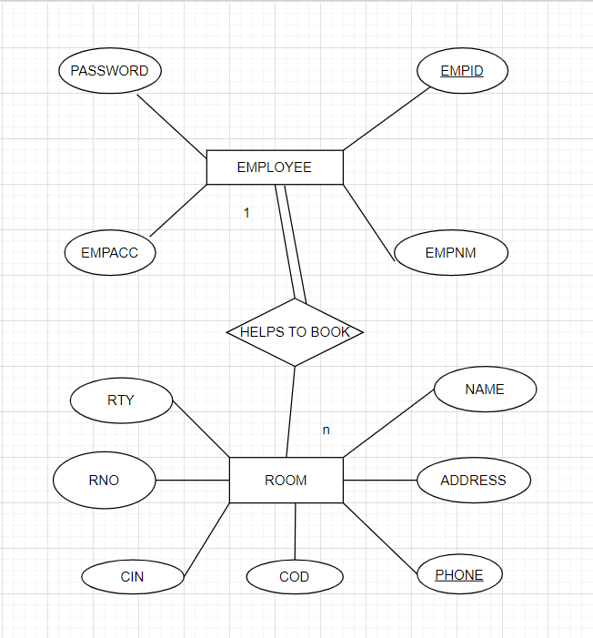
ENTITY RELATIONSHIP DIAGRAM

Slide 7
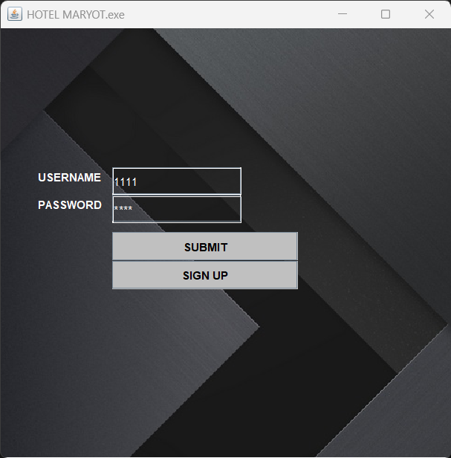
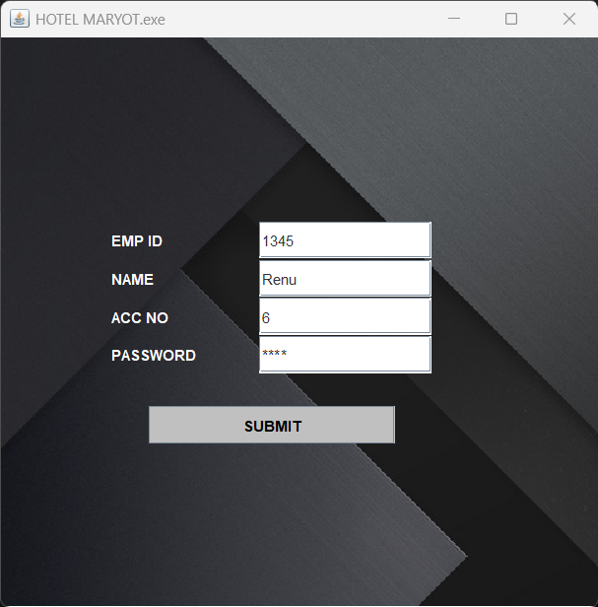
OUTPUT SCREENSHOTS

Slide 8
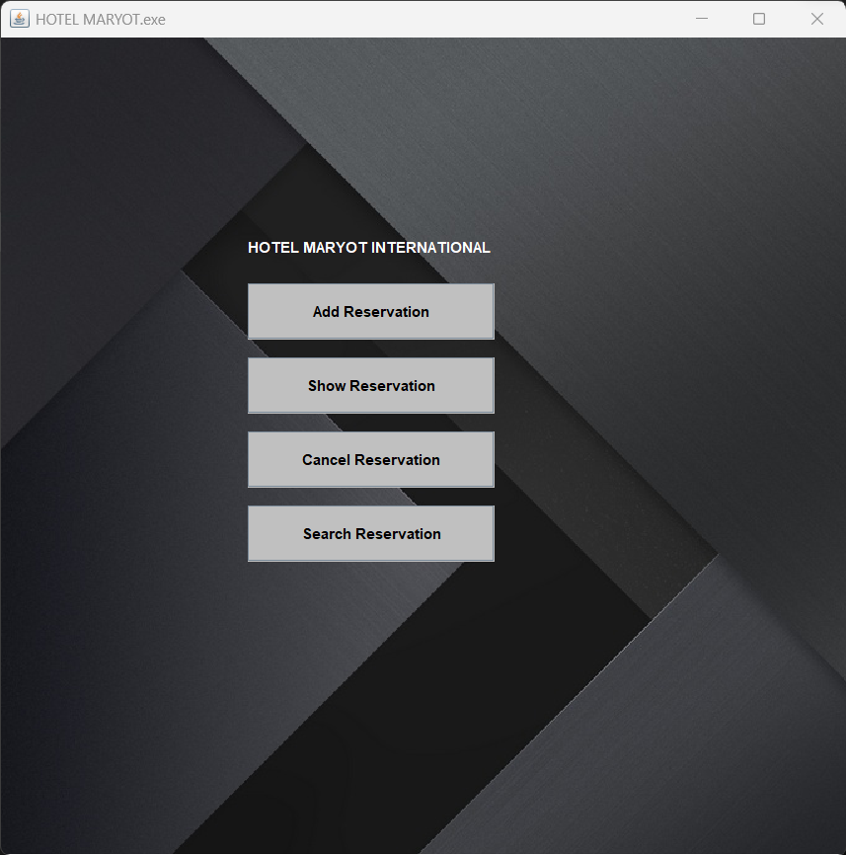
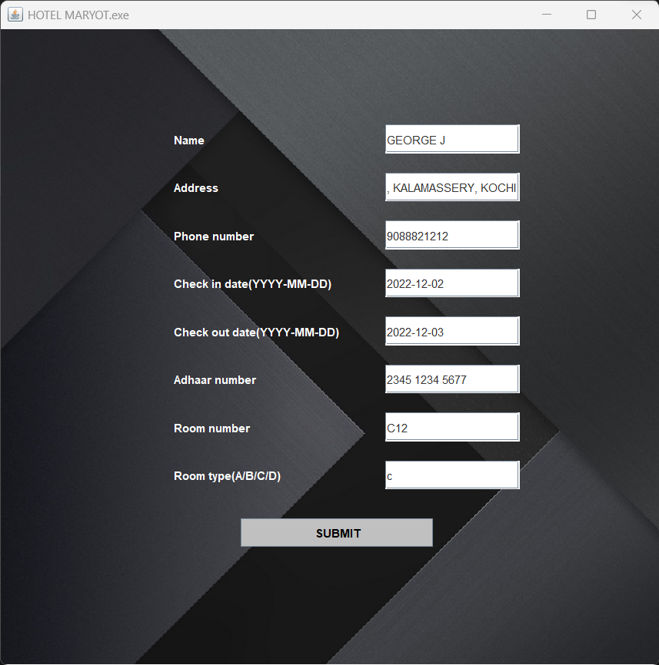

Slide 9
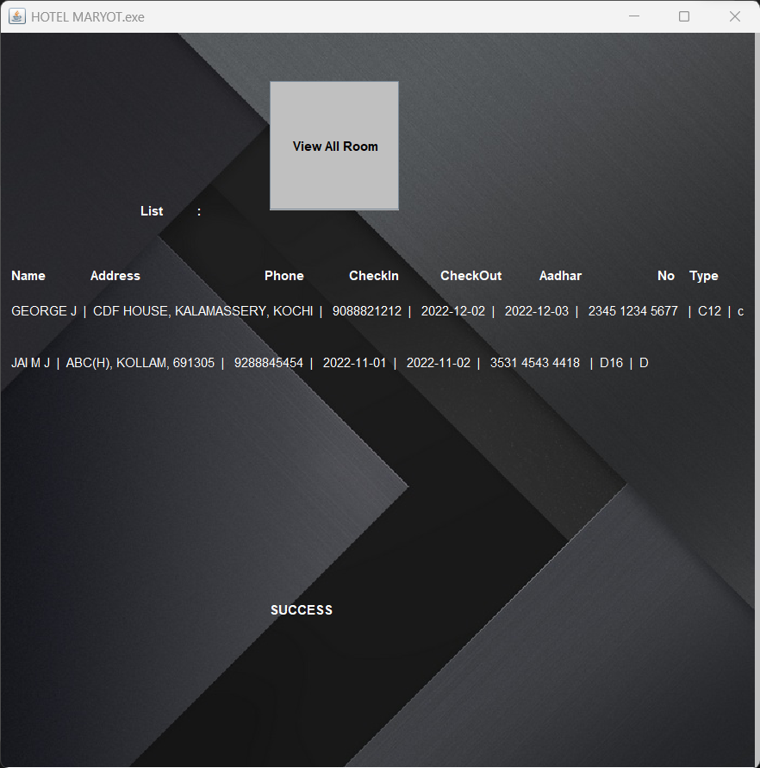
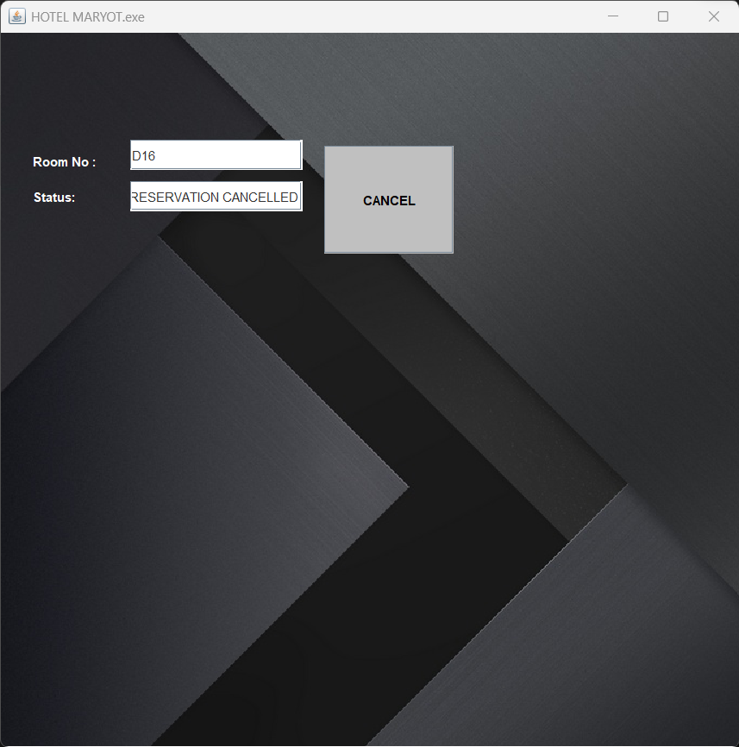

Slide 10
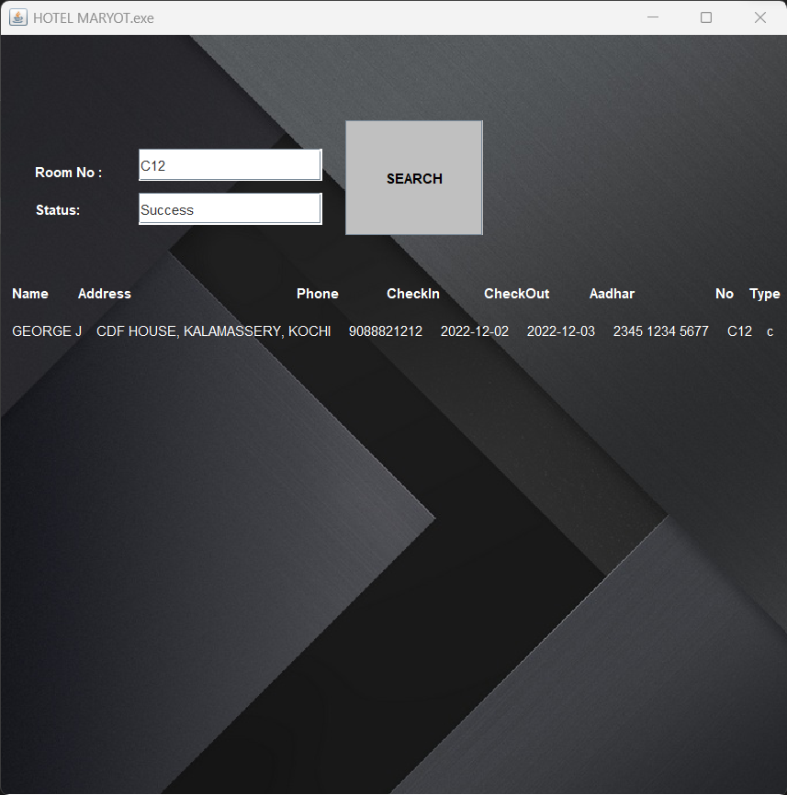

Slide 11
CONCLUSION
An application is developed to help the staff of a hotel in allocating a room, searching for a particular room to see if it is vacant or occupied, to cancel and to show all the rooms that are currently being occupied.
It also stores the data of the customers in the hotel in the database .

Slide 12
REFERNCES
https://www.tutorialspoint.com/javafx-course/index.asp
https://www.tutorialspoint.com/java-database-connectivity-jdbc-database-design-in-java/index.asp
https://stackoverflow.com/questions/1457716/what-is-the-mysql-jdbc-driver-connection-string

Slide 13
THANK YOU

